Slide 1
Novel Contribution
According to a study by the Union of Concerned Scientists (UCSUSA), “transportation contributed more than half of the carbon monoxide and nitrogen oxides, and almost a quarter of the hydrocarbons emitted into our air.”
Pollution affects us and affects the environment.

Slide 2
Novel Contribution Continued..
Car emissions are one of the main contributors for causing air pollution.
The investigation that we have purposed is to explore how smart parking can help solve environmental issues caused by traffic congestion

Slide 3
Novel Contribution Continued…
By having a smart parking system there will be a reduction in traffic since there will be less cars looking for an available and open parking space.
Also, there will be a reduction in air pollution because it will significantly decrease driving time therefore; it will decrease car emissions.

Slide 4
Work by Competitors
The smart parking management system has been implemented in various parts of the world, such as in the United Sates, United Kingdom, Europe, Japan and India.
One of the cities that have introduced the concept of the smart parking assistance program is in Ellicott City, Md.

Slide 5
Work By Competitors Continued..
They have developed a smart parking system that utilizes sensors to detect whenever a parking space is open and then it sends the data information to the drivers to let them know which parking spot is vacant.

Slide 6
Work By Competitors Continued..
According to the article, “A Reservation-based Smart Parking System” by Hongwei Wang and Wenbo He.
They have designed and implemented a prototype called “Reservation-based Smart Parking System (RSPS).”

Slide 7
Work By Competitors Continued..
Reservation-based Smart Parking System (RSPS) depicts and provides in real time parking data information to the drivers through an application
It also, offers parking reservations as part of the system.

Slide 8
Data
The parking dataset comes from the City of Aarhus in Denmark. It contains data from February 2015 until October 2015.
The data file contains the following fields: vehicle count, update time, id, total spaces, and garage code.

Slide 9
Data Continued..
The data was loaded and read in Zepellin.
We imported the “apache spark sql function” and the date time format packages.
Then we adjusted the path and added the location of the data to the script.

Slide 10
Data Continued..
The vehicle count field is the number of vehicles that park in the parking lots.
The total spaces is the number of available parking spots.
Garage code is just the code to enter the garage.

Slide 11
Data Continued..
Postal code is just the city’s postal code
Street is where the house is located.
House number is just the house’s number.
Latitude and the longitude are the geographical coordinates.

Slide 12
Data Continued…
We merged the parking and the pollution dataset in order to add the "ozone” column.
The data fields that we didn’t include when loading our data was the id, update time, and stream time since we believed that those fields didn’t give us any meaningful information.

Slide 13
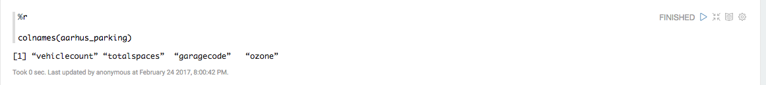
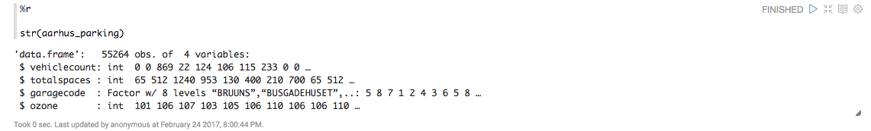
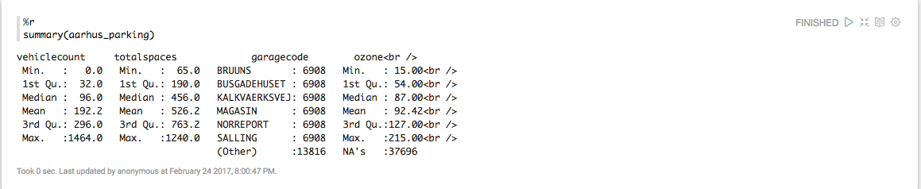
Data Continued…

Slide 14
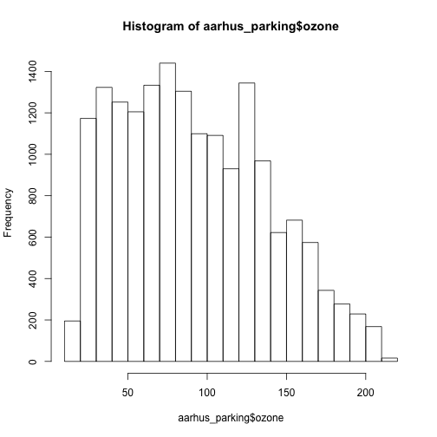
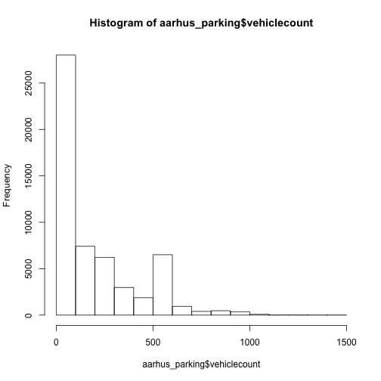
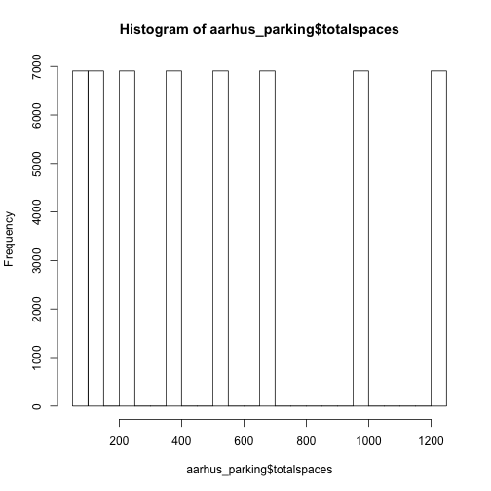
Data Continued…

Slide 15
Method
Our algorithm consists of running a linear regression and a time series analysis.
With linear regression we can fit a predictive model between dependent variable y and explanatory variables.

Slide 16
Method..
For the linear regression analysis we will first load the parking dataset using Zeppelin.
First, we are going to choose our dependent and independent variables.
We are going to take “ozone” as the dependent variable.
“Vehicle count, total spaces, and garage code” as independent variables.

Slide 17
Method..
We will then run the linear regression analysis using the “lm” function.
Check the p-values for each of the parameters.
Identify the parameters that will affect the ozone data field in the model.

Slide 18
Method..
Time series analysis is also going to be used as part of our algorithm.
Time series analysis is used to predict future values based on previously observed values.
This type of analysis is the best method to use for dealing with temporary effects by running the time series analysis.

Slide 19
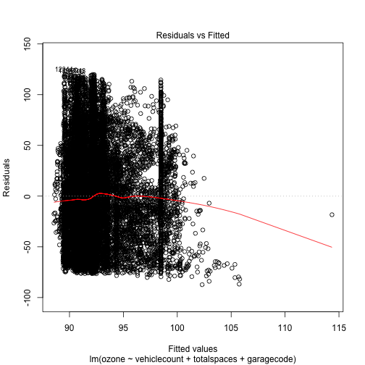
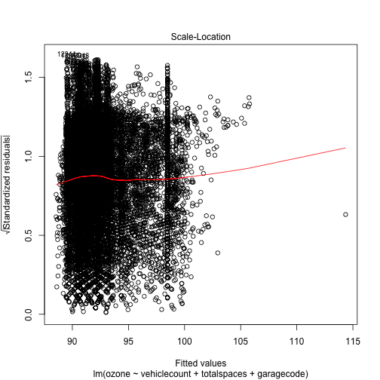
Method...

Slide 20
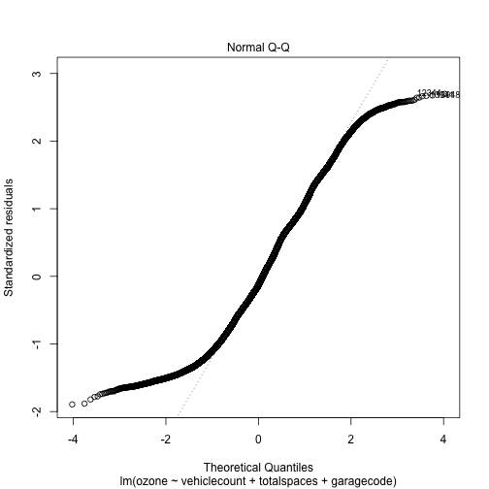
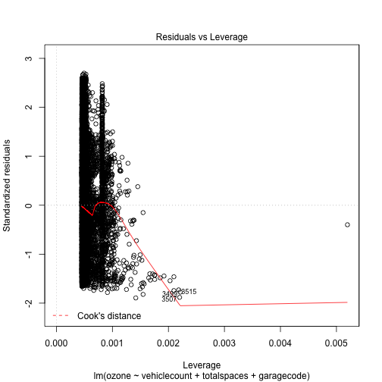
Method..

